Slide 1

VEHICLE DETECTION SYSTEM

Slide 2






THE TEAM
ADNAN SAMAD
STUDENT
ALISHA HAMEED
STUDENT
HAFIZ TAHA
STUDENT
OMER SIDDIQUI
STUDENT
DR.SHARAF HUSSAIN
ASSISTENT PROFESSOR

Slide 3

PROOF OF CONCEPT (POC) REQUIREMENTS
RFID CHIP SHOULD BE SCAN BY SCANNER
DUMB DATA SHOULD BE STORE
COMPONENT DIAGRAM OF SYSTEM ON BIG LEVEL

Slide 4

SYSTEM DIAGRAM
GENERATE
REPORT
RFID DATABASE
STORE VEHICLE
INFORMATION
IN RFID
DATABASE
SENSORS
SCAN NUMBER PLATE
EXCISE DATABASE
LOCATE ON
GOOGLE MAP

Slide 5
ACTOR USECASE DIAGRAM
DASHBOARD
LOGIN
PRINT REPORT
EXCISE DB
<<include>>
REGISTER CHIP
<<include>>
OFFICER
GET OWNER DATA
<<include>>
RFID DB
GET VEHICLE LOCATION
<<include>>
SERVER SITE
CREATE OR REMOVE ACCOUNT
ADMIN

Slide 6
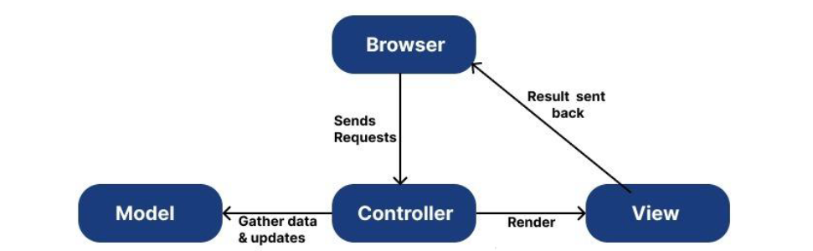
ARCHITECTURE
MVC (Model View Controller):
The Model is responsible for handling the data and logic of the system. In this case, it would handle the information received from RFID and GPS sensors and would process this data to determine if a vehicle is present. It would also handle any algorithms or logic required for the detection system to function properly.
The View is responsible for displaying the information to the user. In this case, it would handle the presentation of the vehicle detection data on a map or in a list. The view would also handle the user interface elements such as buttons, menus, and other controls that the user interacts with.
The Controller is responsible for handling the flow of information between the Model and the View. It would take the information from the Model and pass it to the View, and would also take user input from the View and pass it to the Model for processing. The controller would also handle any updates to the view based on new information from the Model.

Slide 7
CLASS DIAGRAM
VIEW
CONTROLLER
Model
+Login()
+GenerateReport()
+MapView()
+VehicleStatusView()
+LocationHistory()
+IntegerField
+CharField
+Date
+Time
+UdateLocation()
+GetLocation()
+GetRFID_No()
+MatchTagToVehicle()
+UpdateMap()
+UpdateVehicle()
+UpdateStatus()
+GetCoordinates()
+Time()
Vehicle
RFID
GPS
MAP
SCANER 2
SCANER 1
+Vehicle_Owner
+VehicleReqNo
+Make
+Model
+BodyType
+OwnerName
+RFID_No
+VehicleReqNo
+Longitude
+Latitude
+VehicleReqNo
+Date
+Time
+Longitude
+Latitude
+Date
+Time
+RFID_No
+Longitude
+Latitude
+Date
+Time
+RFID_No

Slide 8
ENITITY DIAGRAM
VEHICLE
USER
OWNER
MAKE VARCHAR
MODEL VARCHAR
BODY_TYPE VARCHAR OWNER_NAME VARCHAR
SEATING_CAPACITY NUMERIC
ENGINE_CAPACITY NUMERIC
PK REGISTRATION VARCHAR
FK OWNER_CNIC_NO NUMERIC
FK RFID_TAG VARCHAR
PK USERID VARCHAR
NAME VARCHAR
USER_CNIC_NO NUMERIC
PHONE_NO NUMERIC
PASSWORD VARCHAR
OWNER_NAME VARCHAR
PK OWNER CNIC_NO NUMERIC
PHONE_NO NUMERIC
FK REGISTRATION VARCHAR
GPS
PK LONGITUDE VARCHAR
PK LATITUDE VARCHAR
ADDRESS
SCANNER
FK USERID VARCHAR
FK OWNER_CNIC_NO NUMERIC
STATE VARCHAR
CITY VARCHAR
ZIP NUMERIC
RFID CHIP
FK RFID_TAG VARCHAR
FK LONGITUDE VARCHAR
FK LATITUDE VARCHAR
TIME TIME
DATE DATE
PK RFID_TAG VARCHAR
FK REGISTRATION VARCHAR

Slide 9
SEQUENCE DIAGRAM (CREATING ACCOUNT)
ADMIN
WEB SERVER
RFID DB
1: Enter username and password
2: Verify
Alt If Available
[Yes]
3: Login Successfully
[No]
4: Incorrect username and password
5: Create account
6: Ask for user detail
7: Provide user detail
8: Store detail into database
9: Process
10: Data stored
11: Account created successfully

Slide 10
SEQUENCE DIAGRAM (REGISTER CHIP)
USER
WEB SERVER
RFID DB
EXCISE WEB API
EXCISE DB
1: Enter username and password
2: Check from database
Alt If Available
[Yes]
3: Login Successfully
[No]
4: Incorrect username and password
5: Enter chip number
7: Send chip number
9: Store into database
6: Enter vehicle number
8: Send vehicle number
10: Store into database
11: Successfully Store data

Slide 11
SEQUENCE DIAGRAM (GET LOCATION)
USER
WEB SERVER
RFID DB
1: Enter username and password
2: Check from database
Alt If Available
[Yes]
3: Login Successfully
[No]
4: Incorrect username and password
5: Enter vehicle number
6: Check given number in database
Alt If Available
[Yes]
7: Provide location
[No]
8: Generate error

Slide 12
SEQUENCE DIAGRAM (GET OWNER DATA)
USER
WEB SERVER
RFID DB
EXCISE WEB API
EXCISE DB
1: Enter username and password
2: Check from database
Alt If Available
[Yes]
3: Login Successfully
[No]
4: Incorrect username and password
7: Search given vehicle number into database
5: Enter vehicle number
6: Send vehicle number
Alt If Available
[Yes]
8: Provide details
9: Display details
[No]
11: Display error
10: Generate error

Slide 13
SEQUENCE DIAGRAM (PRINT REPORT)
USER
WEB SERVER
RFID DB
EXCISE WEB API
EXCISE DB
1: Enter username and password
2: Check from database
Alt If Available
[Yes]
3: Login Successfully
[No]
4: Incorrect username and password
6: Check for the date against Vehicle no
5: Enter Vehicle No & Date & time
7: Verify
Alt If Available
[Yes]
8: Provide data
[No]
9: No data found
11: Check from database
12: Verify
10: Request for data
Alt If Available
13: Provide data
[Yes]
14: Provide data
17: Display data
[No]
16: No data found
15: No data found

Slide 14
OPERATION DIAGRAM (ON LARGE SCALE)
Power Supply
raspberry pi 3 model b+
RFID Scanner(Model SPR/A10-8030-9C)
GSM/GPRS
RFID tag
RFID DB
EXCISE DB
Dashboard

Slide 15

NON-WORKING PROTOTYPE

Slide 16


Slide 17
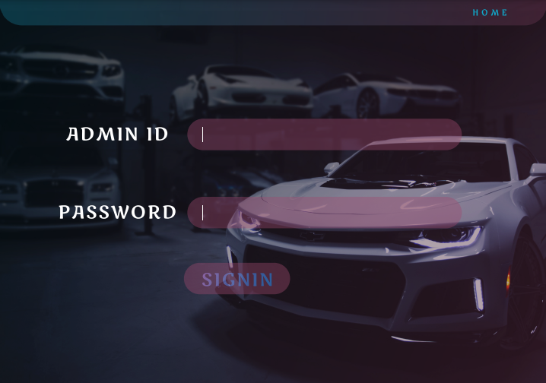

Slide 18
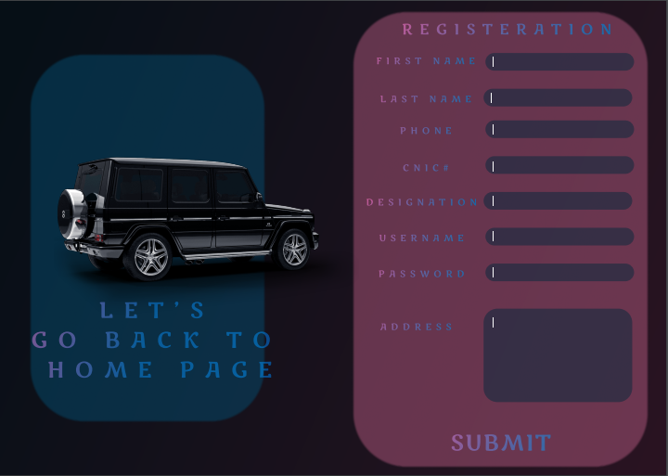

Slide 19
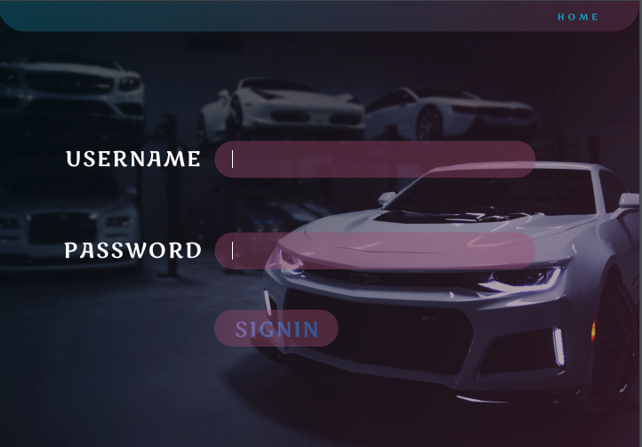

Slide 20
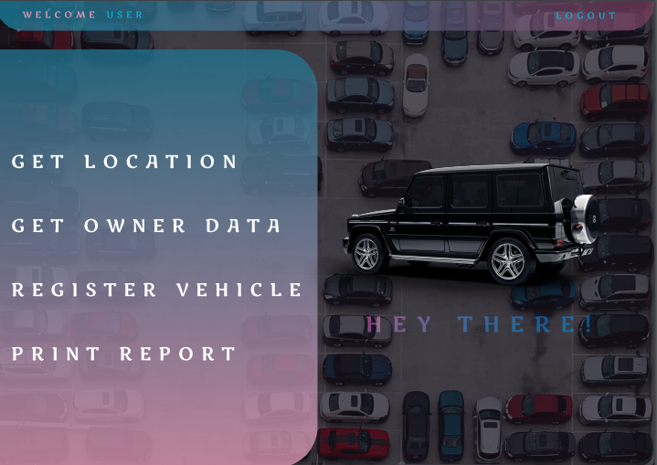

Slide 21
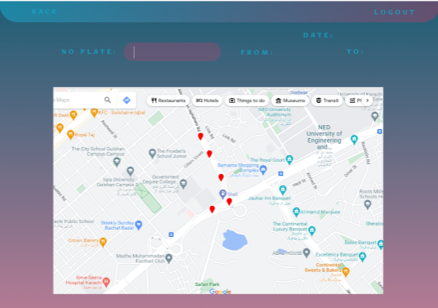

Slide 22
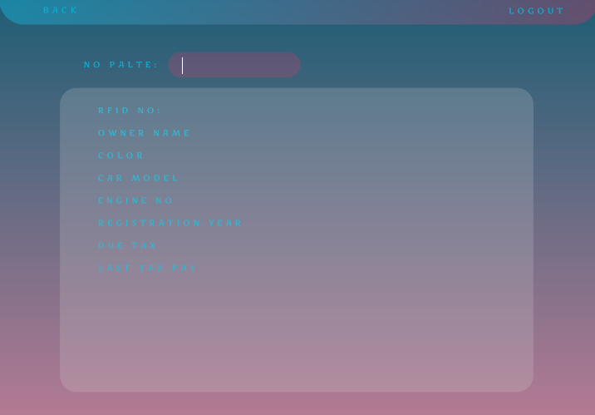

Slide 23
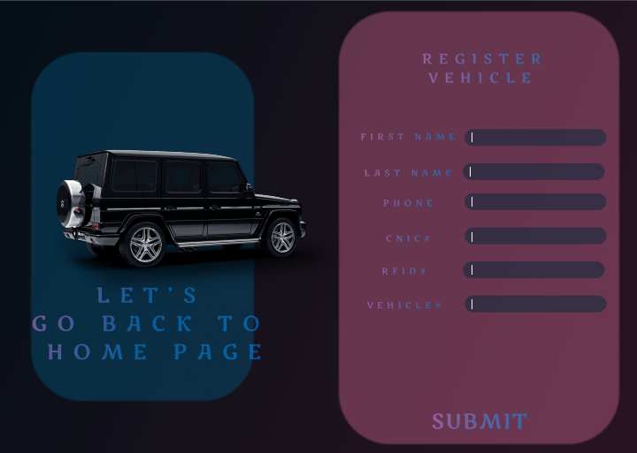

Slide 24
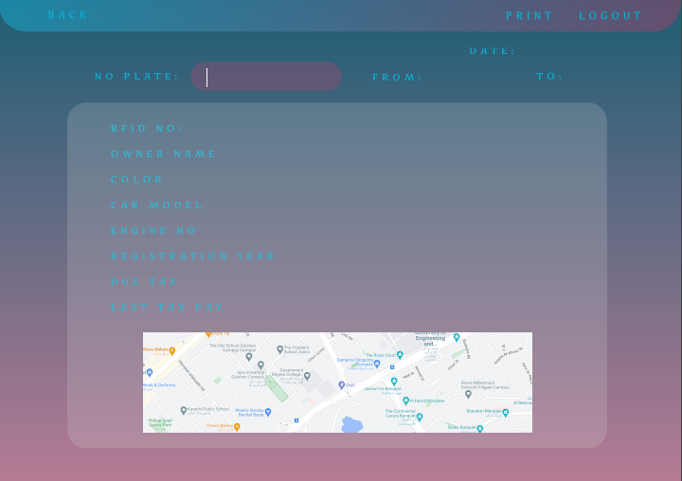

Slide 25
THANK YOU!

